Slide 1

Welcome APC WEB Students and DOST-STII Speakers with APC partners: IBM, CODEDOOR, and ARISE PH
Disaster Risk, Preparedness, Resiliency 101
3 Dec 2020

Slide 2

Disaster Prevention and Mitigation Efforts of DOST
ALAN C. TAULE
Department of Science and Technology

Slide 3






“By harnessing the potentials of science and technology, the DOST is able to find solutions to problems brought about by climate change … we can now use science-based tools for disaster preparedness and mitigation.” -- Secretary Mario G. Montejo

Slide 4
FIRST THINGS FIRST…
THERE IS NO SUCH THING AS A NATURAL DISASTER, ONLY NATURAL HAZARDS (United Nations Office for Disaster Risk Reduction)

Slide 5
IN A NUTSHELL
DISASTER RISK REDUCTION—the concept of reducing disaster risks through systematic efforts to analyze and reduce the root factors of disasters.

Slide 6
DOST in DRRM
Under RA 10121, DOST sits as Vice-Chair for Disaster Prevention and Mitigation at the National Disaster Risk Reduction and Management Council (NDRRMC)
It is also part of the Pre-Disaster Risk Assessment (PDRA) body that maps out strategies in the event of an incoming weather disturbance

Slide 7
Understanding Disaster Risk
Hazard
Exposure
RISK
Vulnerability
Notes:
Understanding the interaction of hazards, exposure and vulnerability is crucial to effective disaster prevention.

Slide 8
IN A NUTSHELL
DISASTER RISK REDUCTION—the concept of reducing disaster risks through systematic efforts to analyze and reduce the root factors of disasters

Slide 9
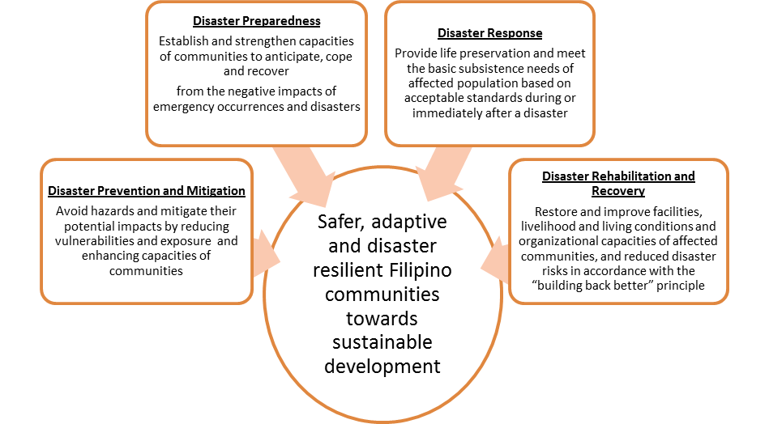
The National DRRM Plan
The 4 distinct and mutually-reinforcing Thematic Areas
Notes:
The National Disaster Risk Reduction and Management Plan emphasizes 4 Thematic Areas with 4 Long-Term Goals which follows the NDRRM Framework, as shown in the illustration. These areas are (1) Disaster Prevention and Mitigation, (2) Disaster Preparedness, (3) Disaster Response and (4) Disaster Rehabilitation and Recovery.
The NDRRM Plan operationalizes this framework through 14 Objectives, 24 Outcomes, 56 Outputs and 93 Activities. There are also 12 Priority Programs and Projects identified in the NDRRM Plan for immediate implementation.
The timelines of the NDRRM Plan are: Short Term, which is from 2011 – 2013, Medium Term from 2014 – 2016 and Long Term 2017 – 2028, depending on the prioritization of the activities as indicated in the NDRRM Plan.

Slide 10
NDRRMP Thematic Area 1: Disaster Prevention and Mitigation
Overall Responsible Agency | Department of Science and Technology (DOST)
Goal | Avoid hazards and mitigate their negative impacts by reducing disaster risk
Objectives | Reduce vulnerability and exposure of communities to all hazards Enhance capacities of communities to reduce their own risks and cope with the impacts of all hazards
Notes:
At this point, in the interest of time, let me just give the highlights of the NDRRM Plan through the Priority Areas and the long-term goals, objectives and outcomes of the Plan.

Slide 11
NDRRMP Thematic Area 1: Disaster Prevention and Mitigation
OUTCOME | LEAD AGENCY
DRRM and CCA mainstreamed and integrated in national, sectoral, regional and local development policies, plans and budget | OCD
DRRM and CCA-sensitive environmental management | DENR
3. Increased resilience of infrastructure systems | DPWH
Community-based scientific DRRM and CCA assessment, mapping, analysis and monitoring | OCD
Communities access to effective and applicable disaster risk financing and insurance | DOF
End-to-end monitoring, forecasting and early warning systems are established and/or improved | DOST

Slide 12
PRE-DISASTER RISK ASSESSMENT
Introduced in 2014 in response to Typhoon Yolanda
PDRA—a system of verification that ultimately determines the protocols to be undertaken in the event of an incoming hydrometeorological hazard
It has been proven effective in coordinating response among all concerned local, regional and national DRRM agencies

Slide 13
PRE-DISASTER RISK ASSESSMENT
Its main features:
Hazard-specific—what is the potential hazard? Impact/s?
Area-focused—what are the areas to be affected? What are the safe areas for evacuation?
Time-bound—how long is the duration of the hazard?

Slide 14
What did we learn from TY Yolanda, Rolly, Ulysses and other severe weather disasters in the past?

Slide 15
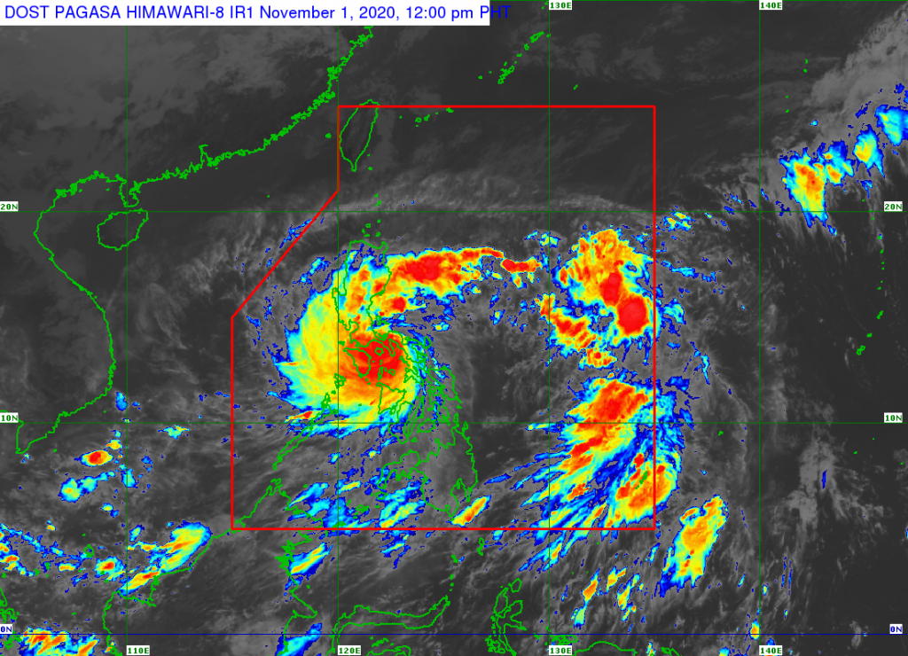
Climate-related disasters have become stronger and more frequent...
TYPHOON ROLLY

Slide 16
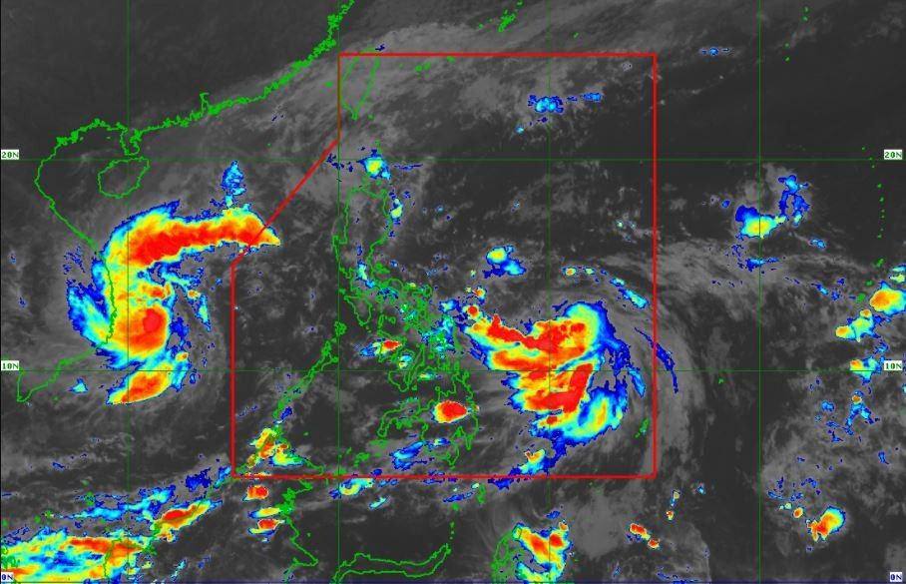
Climate-related disasters have become stronger and more frequent...
TYPHOON ULYSSES

Slide 17
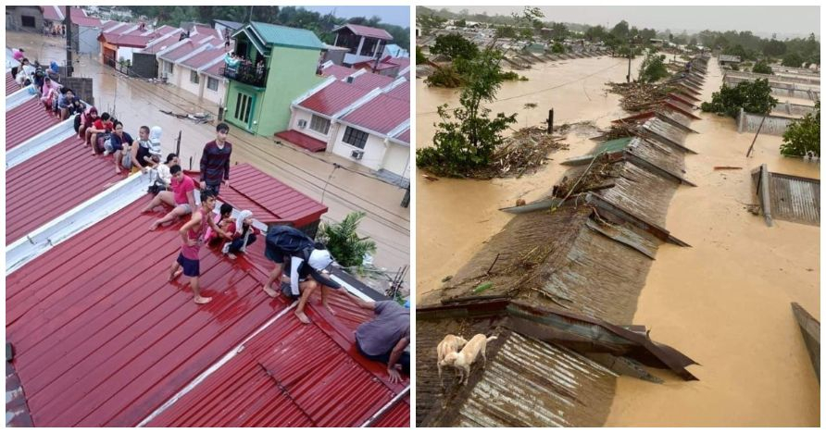
…that it can DISRUPT and affect the way of life and development in multiple regions.
Aerial Photo by: Philippine Air Force

Slide 18
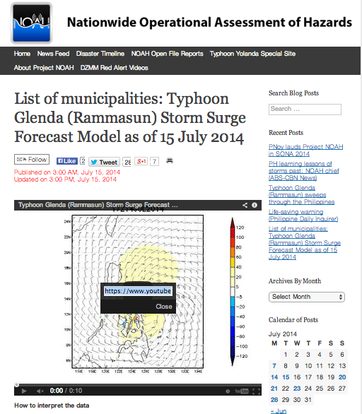
Fast forward to TY Glenda:
We learned that in the face of disasters, the timely and accurate delivery of early warning information can indeed… SAVE LIVES.

Slide 19

Implementation of Community Disaster Preparedness
Step 1: Early
Warning
Step 2: Early
Action
Step 3: Minimum
Loss
Safer Communities
Step 4: Early
Recovery
SCIENCE +
LOCAL KNOW-HOW

Slide 20
4-Point Agenda for Community Preparedness
1. Increase local risk knowledge
2. Capacitate hazards monitoring
3. Test warning and communications protocol
4. Build response capability

Slide 21
Better Early Warning System and Information Channels
Complement PAGASA weather information with CBFEWS (community-based flood early warning systems) and lists of communities at risk of danger (killer factors) from natural hazards
Increase the capacity of local communities to understand early warning systems
Move from current forecasting capability to long-term business and service continuity

Slide 22
Forecasting Across Timescales
Through PAGASA, DOST is ramping up efforts for responsive and relevant research in support of the country’s climate change adaptation (CCA) and disaster risk reduction (DRR) efforts
Forecasting capabilities now can model storm surges 48 hours before landfall to guide disaster responders and communities.
Assist LGU’s in establishing recovery time objectives

Slide 23
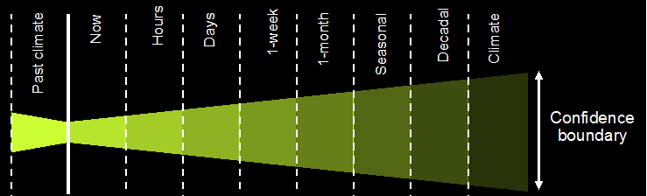
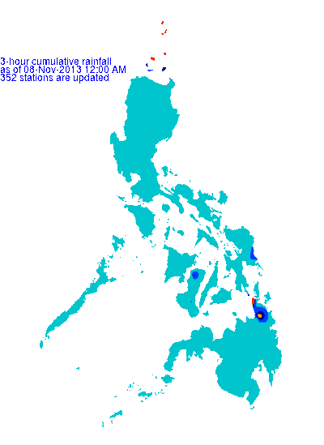
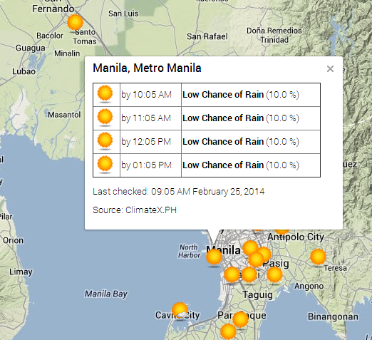

Slide 24
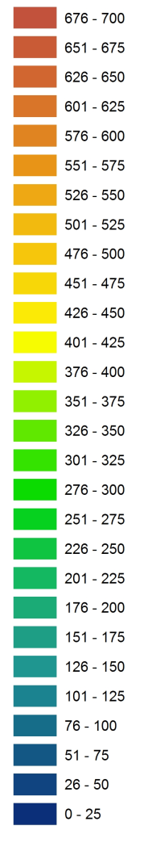
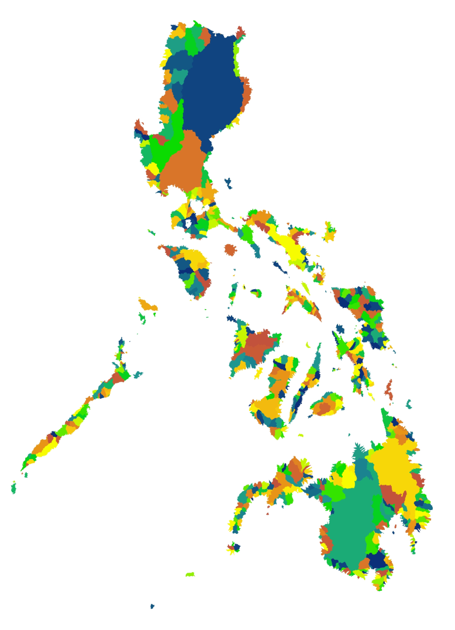
Examples
Forecast volume of accumulated rainfall over 24 hours per watershed to give a flood warning lead time by at least a day.
Rainfall in millimeters

Slide 25
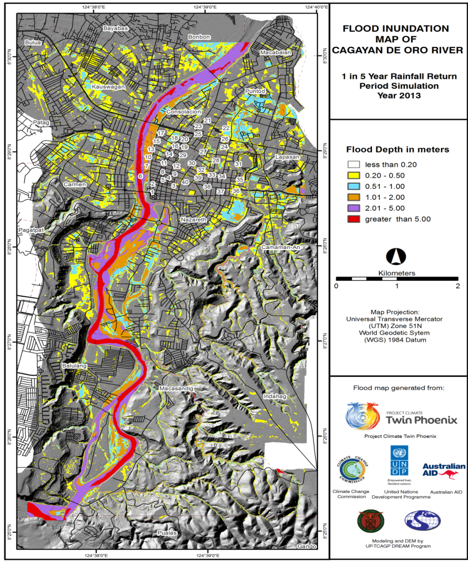
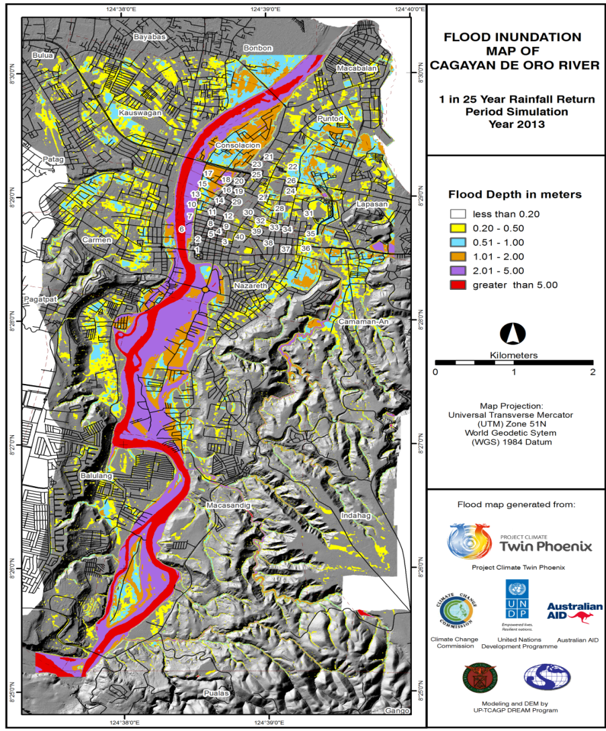
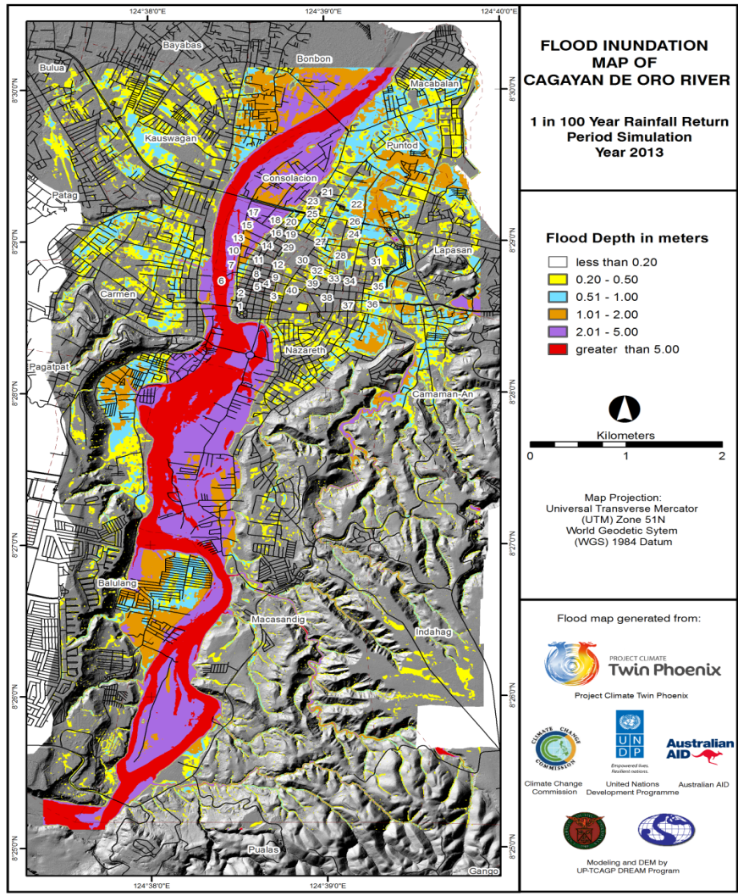
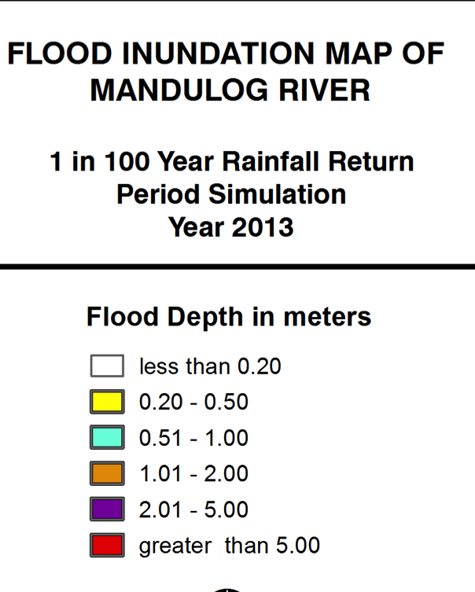

Proposed Flood Advisory System
190mm rainfall in 24hrs
Examples
129mm rainfall in 24hrs
240mm rainfall in 24hrs
Flood Advisory
#1
Flood Advisory
#2
Flood Advisory
#3

Slide 26
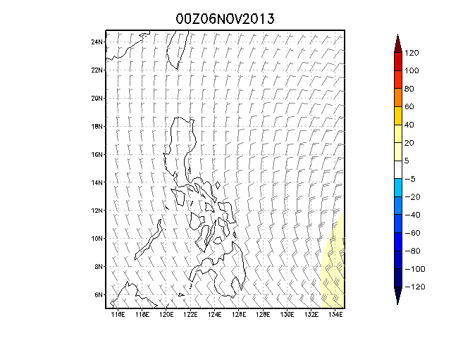
Examples
Storm surge forecasts at least 2 days in advance;
Typhoon track, strength, warnings, days in advance
Storm surge height in cm

Slide 27
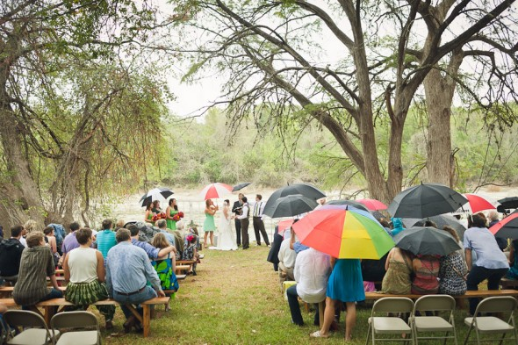
Examples
Events planning; hydropower; transport planning; business planning; general weather

Slide 28
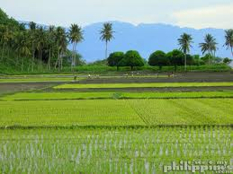
Examples
Agricultural planning; reservoir control; energy; commerce; state planning, drought, etc.

Slide 29
Examples
Rainfall (mm)

Slide 30
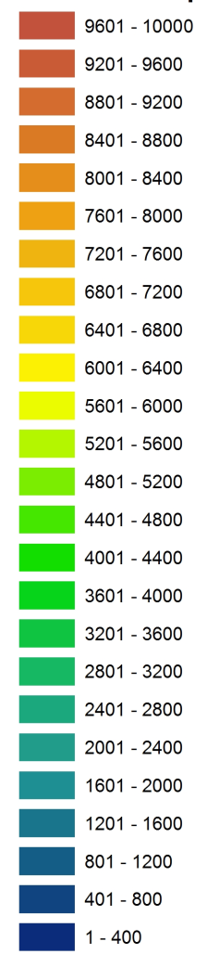
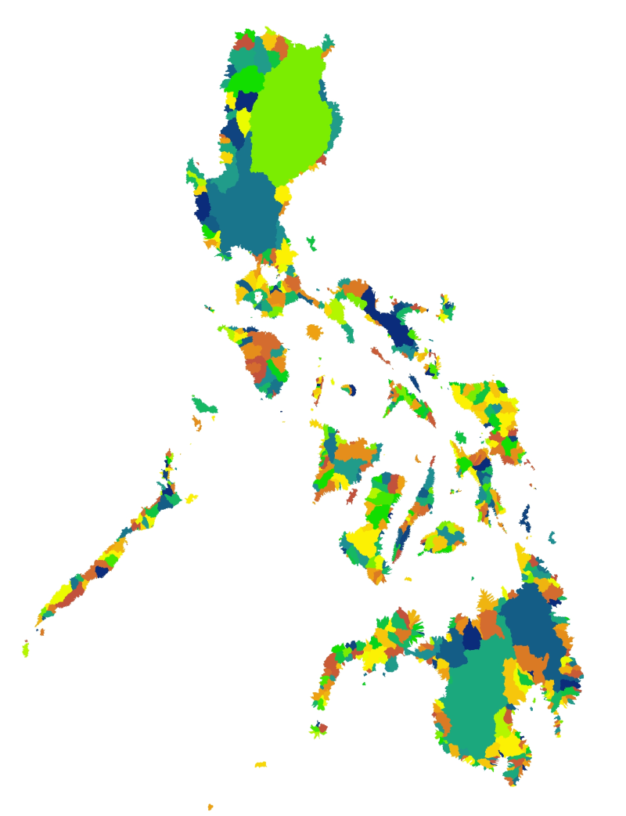
Examples
Rainfall forecast with climate change projections for each watershed
millimeters

Slide 31
IMPORTANT
ICT tools are used in DRRM to better understand disasters and communicate effectively early warning systems and proper response both during and after disaster events to enable disaster managers to mitigate losses.

Slide 32
ICT Risk Communication
Information in itself is not knowledge. Just being aware of danger does not reduce a community’s exposure to risk.
Using the right information to make better decisions is the next step.

Slide 33
Let’s work together in building a
safer, disaster-proof Philippines!

Slide 34


